Slide 1


ASTOS Monte-Carlo
Simulation Setup
Jason Ong

Slide 2

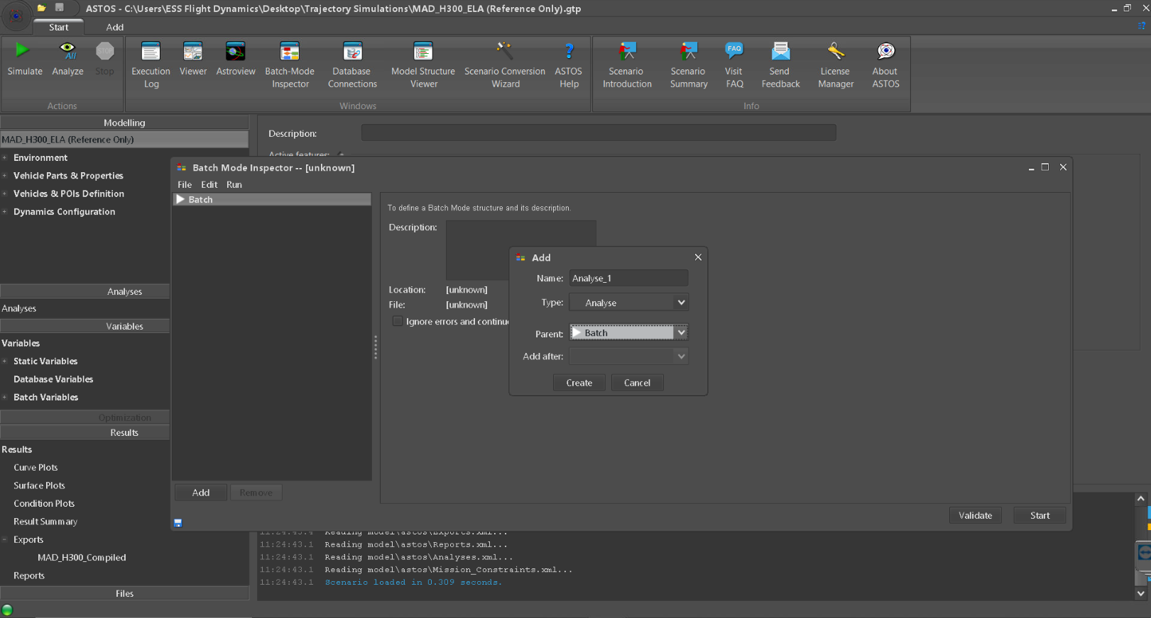

Slide 3

Batch mode commands (see ASTOS user manual for full descriptions)

Slide 4
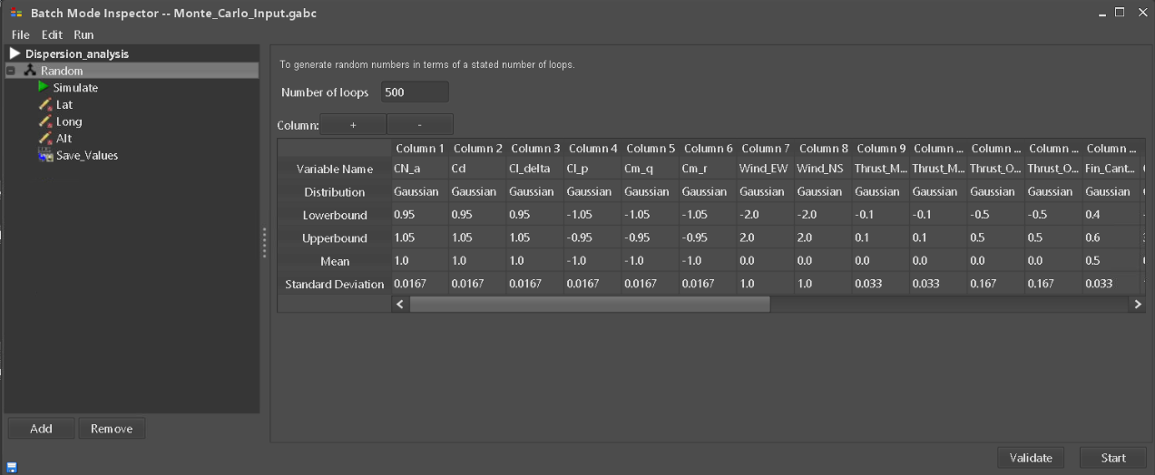
Typical Monte-Carlo Setup
Specify statistical parameters for each variable

Slide 5
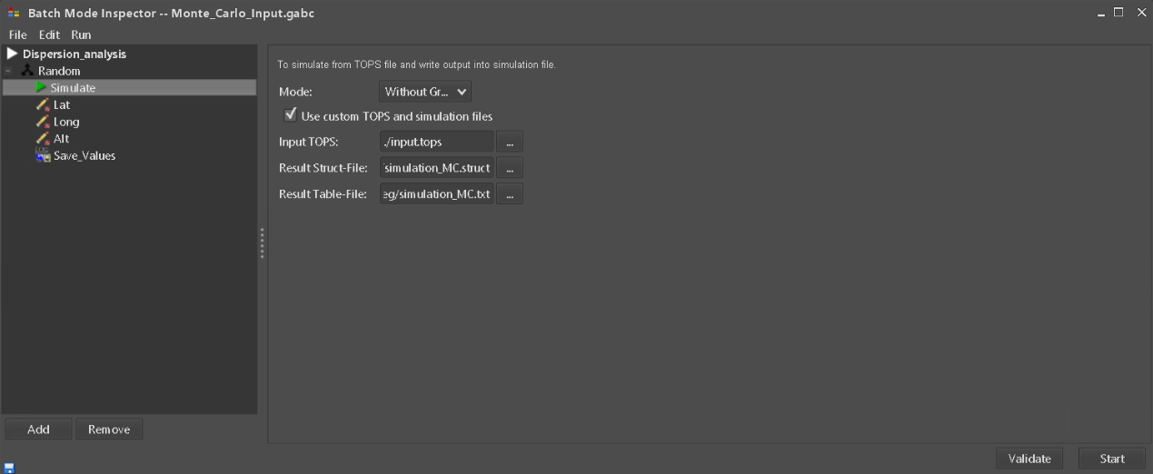
Typical Monte-Carlo Setup
Specify struct file and table file for data collection

Slide 6
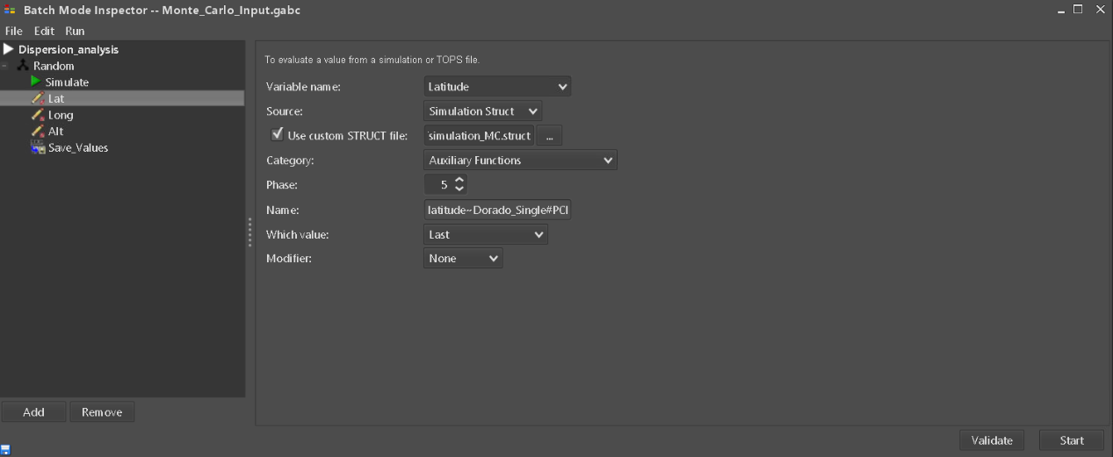
Typical Monte-Carlo Setup
Specify variable name where value is to be stored
Specify struct file where trajectory simulation is stored
Select phase from which value is to be extracted
Specify variable of interest within the simulation
Select type of value: max., min., first, last, etc.

Slide 7
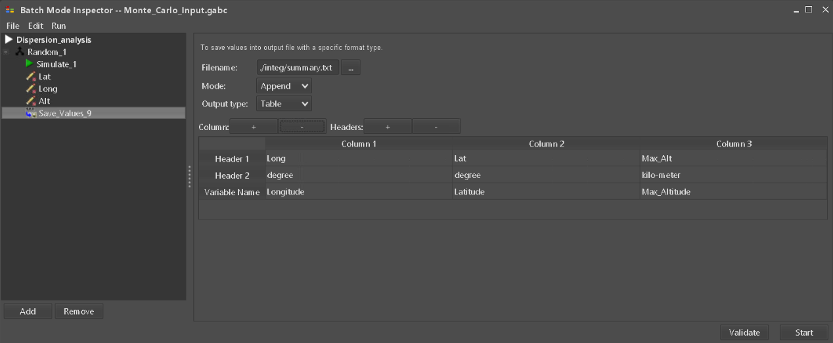
Typical Monte-Carlo Setup
Specify location of file where data is written to
Specify variable to be logged along with its respective header names

Slide 8
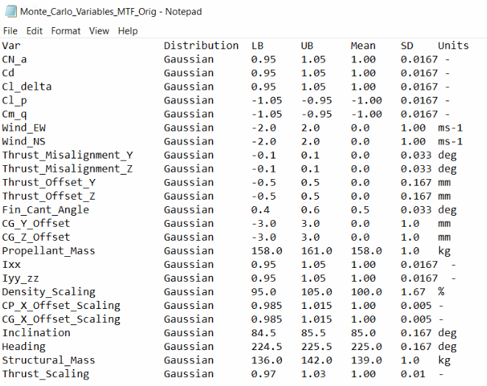
Alternative Methodology
Generation of .xml file using Bash scripting
Manipulate input data (right) as opposed to manual input through GUI

Slide 9
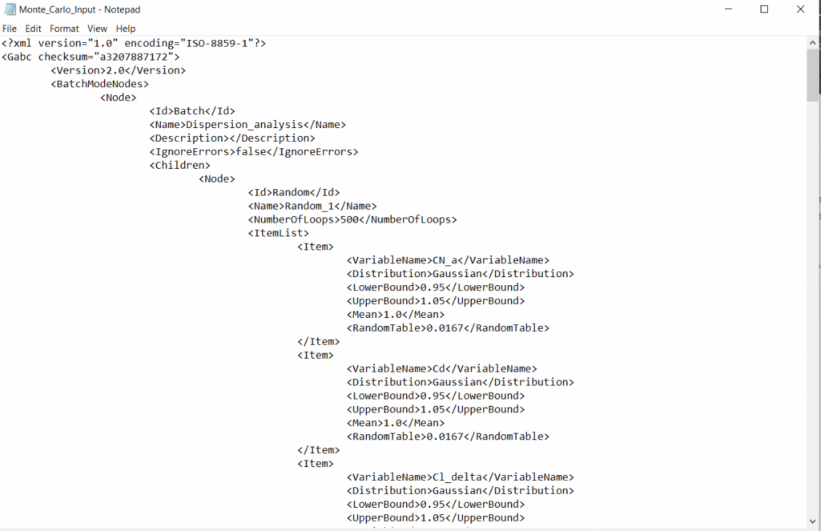
Alternative Methodology
Generation of .xml file using Bash scripting
Non-iterative text generation
Iterative text generation in Bash script

Slide 10
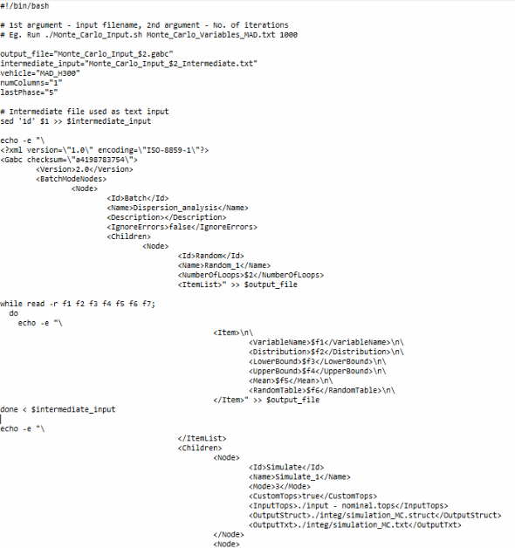
Sample Bash
Script
Variable definitions
Initial part of XML file
Set Monte Carlo parameters using while loop
Set simulation node

Slide 11
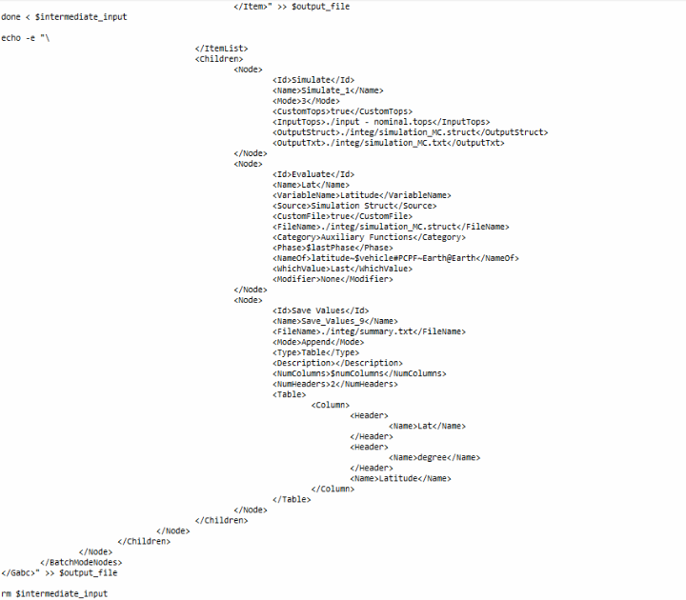
Sample Bash
Script (continue from previous)
Set evaluation node
Set save node for data collection
Final part of XML file

Slide 12
Sample Bash
Script (continue from previous)
Set evaluation node
Set save node for data collection
Final part of XML file

